Slide 1
Thesis Defense:
Web-Based Relational Geodatabase of Glaciers in California SSCI 594 Spring 2020
Chase VanSchoonhoven

Slide 2
Research Goals
Archive and store the large amounts of glacial data from various sources, as well as meet the current requirements and standards of existing global glacial databases.
Design the database in such as way as to make the data easily accessible and useful for various users with various purposes.
SSCI 594 | 2
Notes:
User Groups: Geologists / Glaciologists, Policy Makers, General Public.
Purpose: Next Slide – Importance of Glacial Monitering

Slide 3
Motivation
Limitations of other glacial inventories and databases
Lack of temporal data of California Glaciers
Incomplete data dispersed across various datasets
Importance of glacial monitoring
Benefits to the environment
Hazards to the environment
Geopolitical boundaries
Indicator of changes in regional and global climate
SSCI 594 | 3

Slide 4
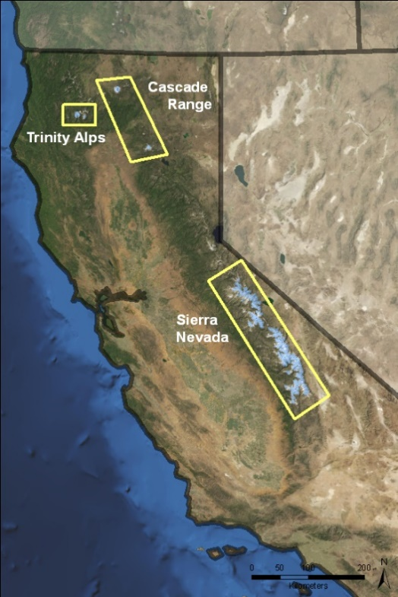
Study Area
California Glacial Regions
Sierra Nevada
Trinity Alps
Mount Lassen (Cascade Range)
Mount Shasta (Cascade Range)
SSCI 594 | 4
Notes:
1700 snow or ice bodies which cover more than 46km² of California.
20 of them are named, 13 of which are in Sierra Nevada while the other seven are around Mount Shasta (Whitney, Bolam, Hotlum, Konwakiton, Watkins, Mud Creek, and Wintun)

Slide 5
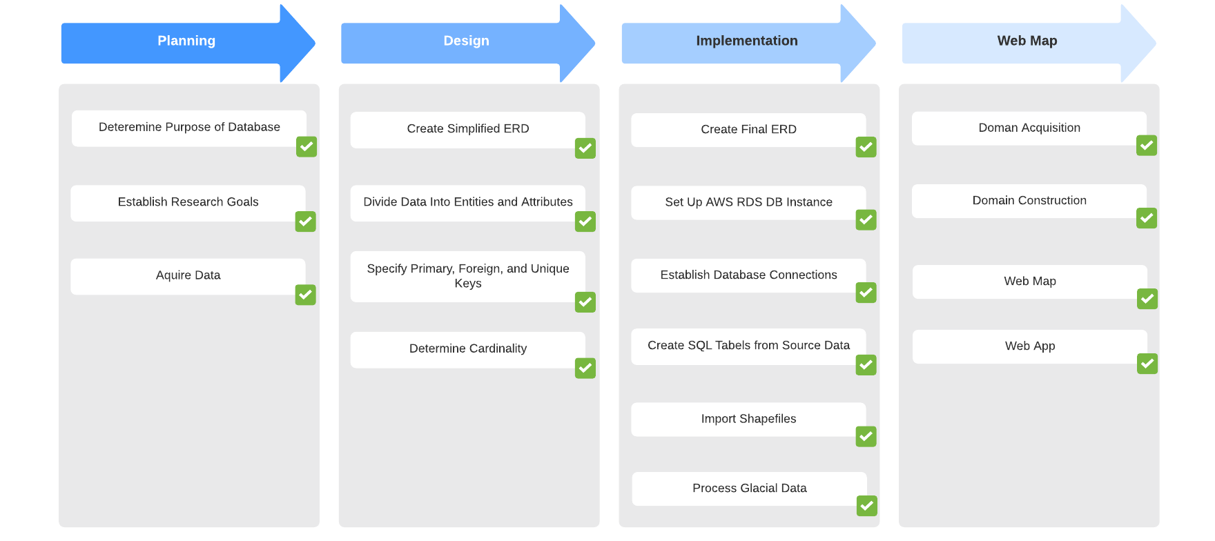
Workflow
SSCI 594 | 5

Slide 6
Background Research
Glacial Databases and Inventories
GLIMS (Global Land Ice Measurements from Space
IAD (A web-based, relational database for studying glaciers in the Italian Alps)
Spatial Temporal Database Design
Yeung and Hall’s Spatial Database Systems
Wachowicz’s Object-Oriented Design for Temporal GIS
Allen’s Focus on Geodatabases
Temporal Database Design Articles
GIST Thesis’
SSCI 594 | 6
Notes:
Temporal Database Design Articles
ESRI
Microsoft
GIST Thesis’
Borer - Creating a Water Quality Geodatabase for the West Hawai‘i Island Region
Blee - Creating a Geodatabase and Web-GIS Map to Visualize Drone Legislation in the State of Maryland
Kelley - Creating a Well Database and Web Mapping Application: Using Geographic Information Systems to Manage and Monitor Groundwater Resources in Sonoma County, California
Khan - A Unified Geodatabase Design for Sinkhole Inventories in the United States

Slide 7
Database Design and Implementation Overview
Design Principles
Insight from Glacier Studies
Insight from Key Glacier Database Models
Refinement of Existing Database Models
Identification of Features
Choice of Software
Implementation of Geodatabase
Geodatabase structure
AWS Set Up
Database Connections
Geodatabase Preparation
Creation of SQL Tables from Source Data
Importing Shapefiles
Web Map Creation
SSCI 594 | 7
Notes:
Choice of Software - pgAdmin, pgModeler, PostGIS 2.0 ShapeFile Import/Export Manager, ArcGIS Pro, ArcGIS Web Map, ArcGIS Web Apps

Slide 8
Data Sources
Glacial Datasets:
GLIMS (Global Land Ice Measurements from Space)
RGI (Randolph Glacier Inventory)
NHD (National Hydrography Dataset)
WGI (World Glacier Inventory)
Glaciers of the American West
Other Datasets:
U.S. Census Bureau TIGER Products
NHD (National Hydrography Dataset)
Glacial Regions (Glaciers of the American West)
SSCI 594 | 8
Notes:
All glacial datasets have no temporal resolution for glaciers in California.
Other Datasets:
TIGER – ca_places, ca_counties
NHD – Water Basins (6 Digit Hydrological Unit)
NSICD – Attachments

Slide 9
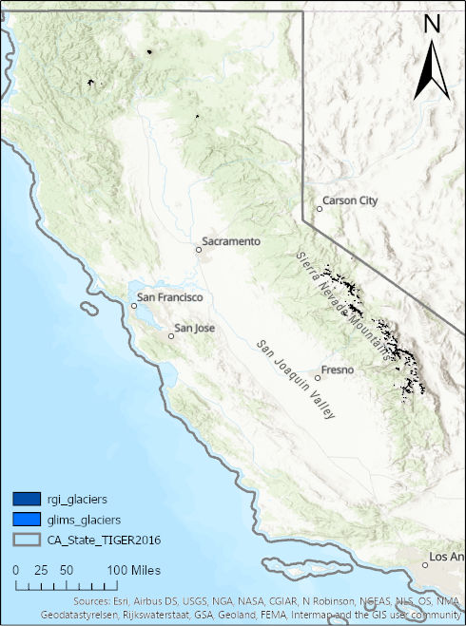
Data Analysis
GLIMS (Global Land Ice Measurements from Space)
Vector - Shapefiles – Polygons and Points
960 features in dataset for California
Feature data from 2006 analysis using imagery from
1953 to 1984
RGI (Randolph Glacier Inventory)
Vector - Shapefile – Polygons
960 features in dataset for California
Feature data from 2001 to 2006
Uses GLIMS ID number
Has the most attributes of glacial datasets
SSCI 594 | 9

Slide 10
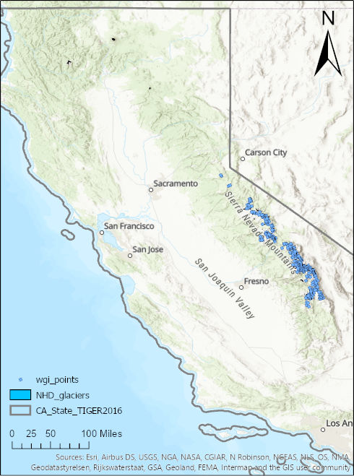
Data Analysis
NHD (National Hydrography Dataset)
Vector - Shapefile – Polygons
1710 features in dataset in California
Feature update data from 2002 to 2018
Uses different ID number than GLIMS or RGI
WGI (World Glacier Inventory)
Vector – Shapefile – Points
497 features in dataset in California
Feature contributed in 2008
Uses different ID number than GLIMS or RGI
Contains additional attributes not in other datasets,
but less features than the other datasets.
SSCI 594 | 10
Notes:
Glaciers of the American West – Only 95 features, Shapefile, Polygons,

Slide 11
Data Analysis
GAW (Glaciers of the American West)
Vector - Shapefile – Polygons
95 features in dataset
No feature contribution date (Published in 2005)
SSCI 594 | 11
Notes:
Glaciers of the American West – Only 95 features, Shapefile, Polygons,

Slide 12
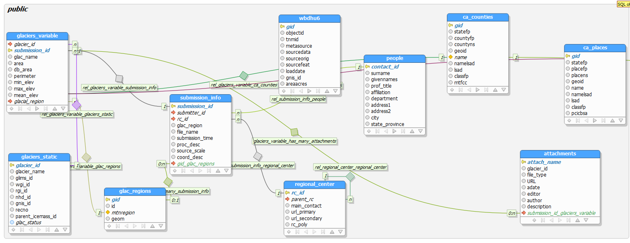
Final ERD (Simplified)
SSCI 594 | 12
Notes:
Simplified – More complete ERD is in e-mail with this PPT

Slide 13
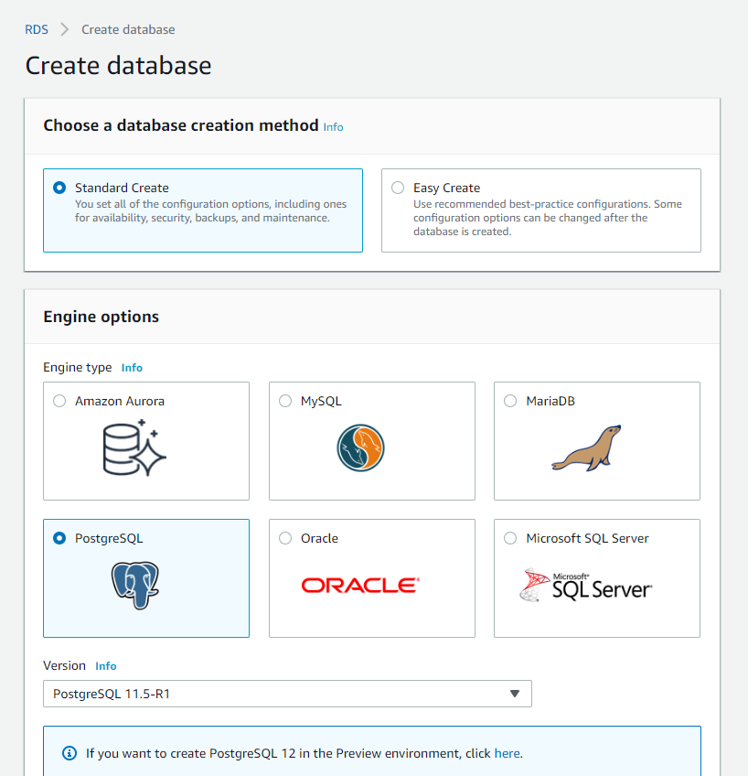
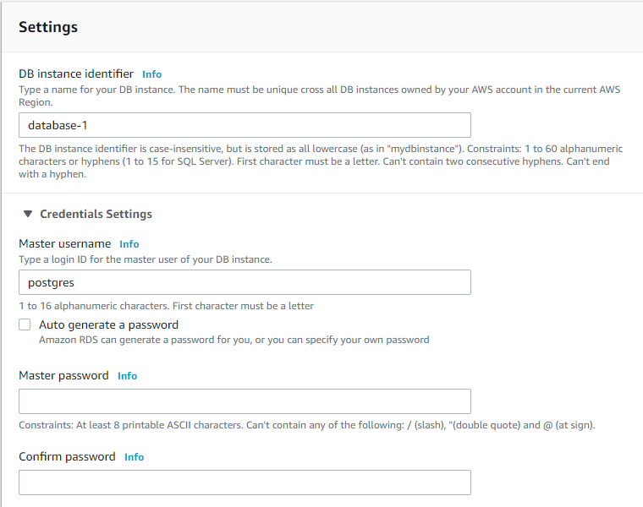
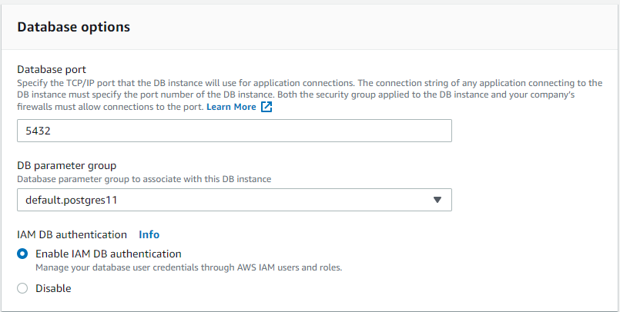
Implementation
Set up AWS RDS Instance using PostgreSQL for DB engine
SSCI 594 | 13

Slide 14
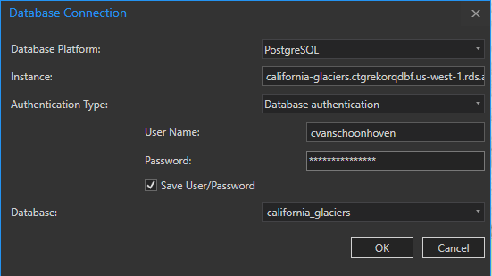
Implementation
Established Database Connections
Connect AWS to ArcGIS Pro
Connect AWS to pgModeler
Connect AWS to pgAdmin
Connect AWS to PostGIS 2.0 ShapeFile Import/Export Manager
SSCI 594 | 14

Slide 15
Implementation
Geodatabase Preparation
Imported Shapefiles (ca_counties, ca_places, wbdhu6, glac_regions) using PostGIS 2.0 ShapeFile Import/Export Manager
Created Tables (glacier_variable, glaciers_constance, glac_regions, regional_center, people, submission_info) using SQL in pgAdmin
Set Constraints in pgAdmin
Set Primary Keys
Set Unique fields
Set Foreign Keys
SSCI 594 | 15

Slide 16
Implementation
Creation of SQL Tables from Source Data
Example for attachments table:
CREATE TABLE public.attachments (
attach_name text NOT NULL,
glacier_id character varying(20),
file_type character varying(4),
"URL" text,
adate date,
editor text,
author text,
description text,
glacier_id_glaciers_variable character varying(20),
CONSTRAINT attachments_pk PRIMARY KEY (attach_name)
);
COMMENT ON COLUMN public.attachments.adate IS 'data of publication';
ALTER TABLE public.attachments OWNER TO cvanschoonhoven;
SSCI 594 | 16

Slide 17
Processing Glacial Data – glaciers_static
Project RGI and GLIMS data to GCS North American 1983
Use SPATIAL JOIN in ArcGIS Pro on glacier data sets to fill glaciers_static data
One to One
Keep all Target Features
Add one additional field for each glacier data set id
Match Option: Interest
Use TABLE TO TABLE to export feature to csv
Use SQL in pgAdmin import CSV data to update the glacers_static table
SSCI 594 | 17

Slide 18
Processing Glacial Data – glaciers_variable
Project RGI and GLIMS data to GCS North American 1983
Use MERGE in ArcGIS Pro on glacier data sets to fill glacier_variable data
Use the Field Map parameter to reconcile schema differences
Use PostGIS 2.0 ShapeFile Import/Export Manager to Append glaciers_variable with merged data sets.
SSCI 594 | 18

Slide 19
Glacial Data Attributes
Example – glaciers_variable 56 attributes (sample shown below)
Name | Type | Default Value | Attributes
glacier_id | character varying(20) |  | NOT NULL
submission_id | integer |  | NOT NULL
glac_name | character varying(28)
area | numeric
db_area | numeric
perimeter | numeric
min_elev | numeric
max_elev | numeric
mean_elev | numeric
SSCI 594 | 19
Notes:
num_basins smallint,
fcode integer DEFAULT 37800,
date timestamp NOT NULL,
geom public.geometry,
max_width numeric,
max_length numeric,
slope smallint,
aspect smallint,
connect smallint,
surging smallint,
linkages smallint,
form smallint,
term_type smallint,
x_coord numeric,
y_coord numeric,
loc_unc_x smallint,
loc_unc_y smallint,
glob_unc_x smallint,
glob_unc_y smallint,
prime_class smallint,
frontal_char smallint,
long_char smallint,
tongue_act smallint,
moraines1 smallint,
moraines2 smallint,
source_nourish smallint,
min_elev_exp smallint,
mean_elev_acy smallint,
mean_elev_abl smallint,
activity_start smallint,
activity_end smallint,
snowline_acy smallint,
snowline_date smallint,
mean_depth smallint,
deapth_acy smallint,
area_acy smallint,
area_exp smallint,
mean_width smallint,
mean_length smallint,
max_len_ex smallint,
max_len_ab smallint,
orient_acc text,
orient_abl text,
remarks text,

Slide 20
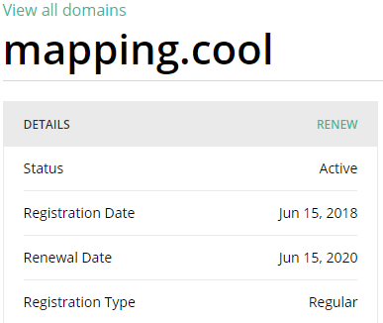
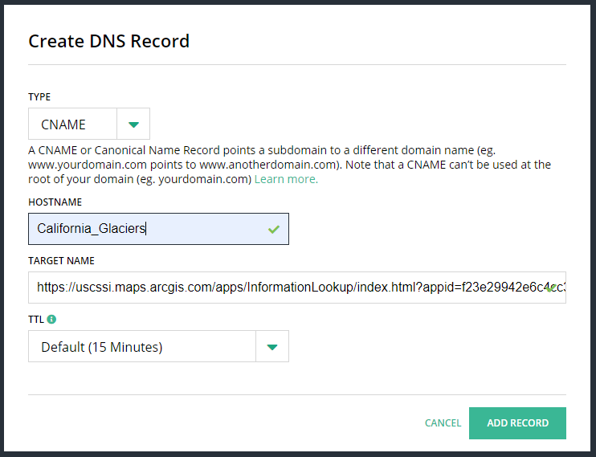
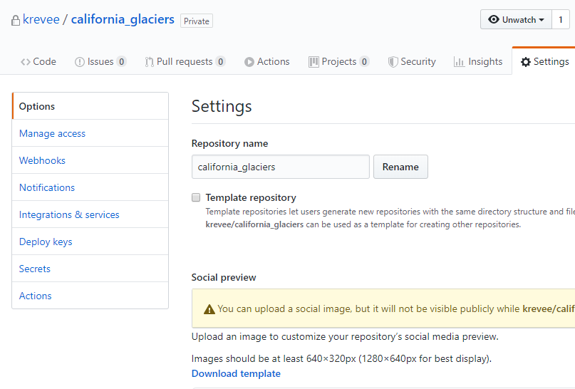
Web Map Creation
Domain Acquisition & Construction
mapping.cool/California-glaciers
GitHub
SSCI 594 | 20
Notes:
Domain > Web Map > Web App
Github – geodatabase, data, methods, documents, and other source material to be posted on Github

Slide 21
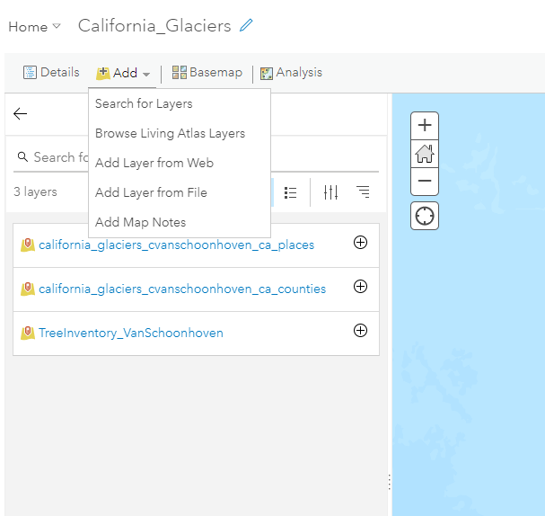
Web Map Creation
Sharing > Share as Web Layer
Add to Web Map
SSCI 594 | 21
Notes:
Domain > Web Map > Web App
-Create maps in ArcGIS Online
-Share maps to be used in Story Maps

Slide 22
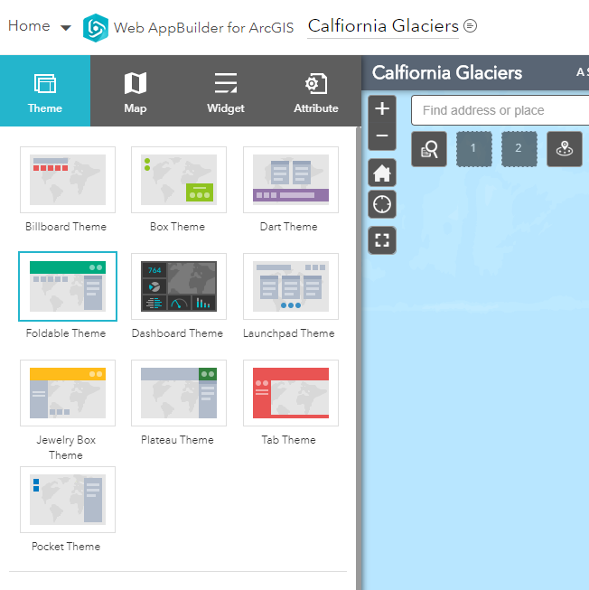
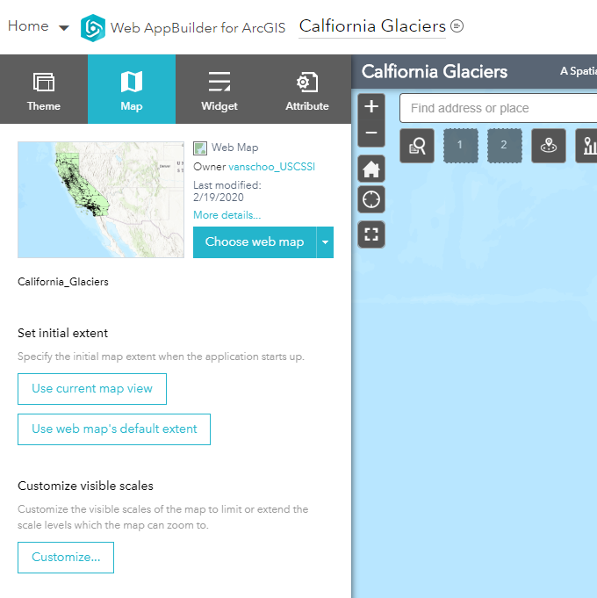
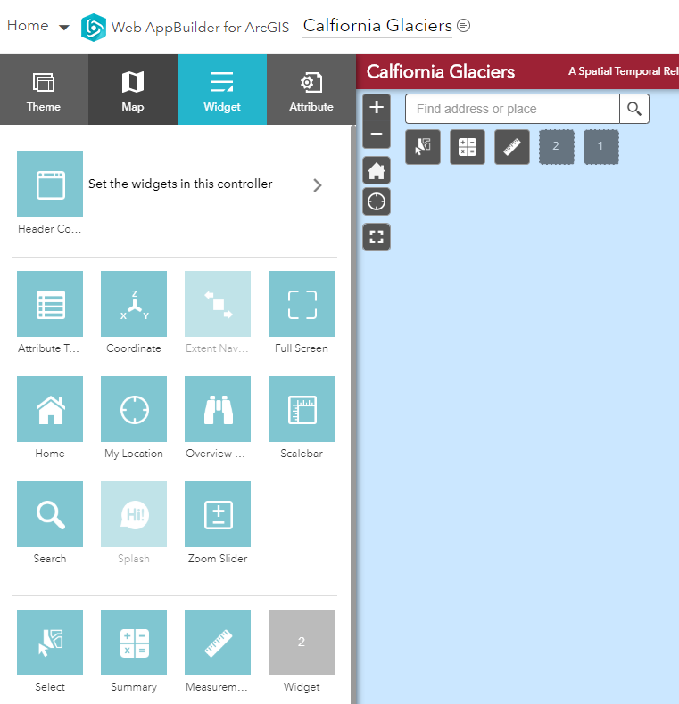
Web Map Creation
Web App
SSCI 594 | 22
Notes:
Domain > Web Map > Web App
-Create maps in ArcGIS Online
-Share maps to be used in Story Maps

Slide 23
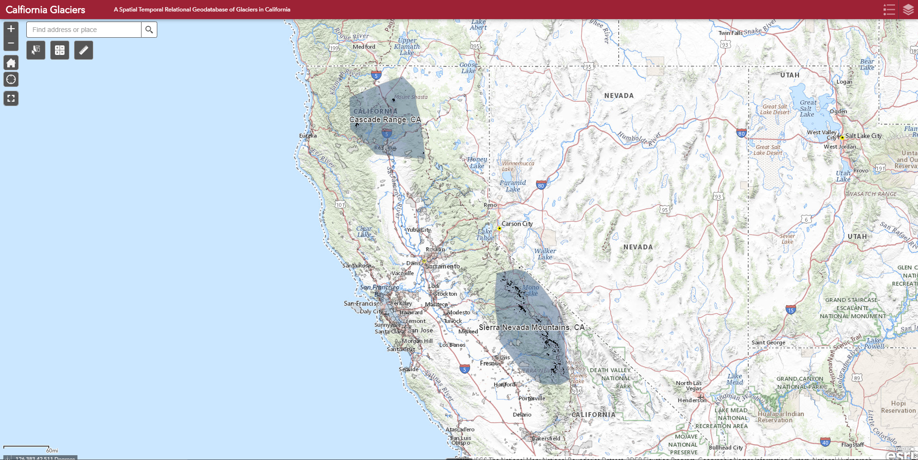
Web Map Demo
SSCI 594 | 23

Slide 24
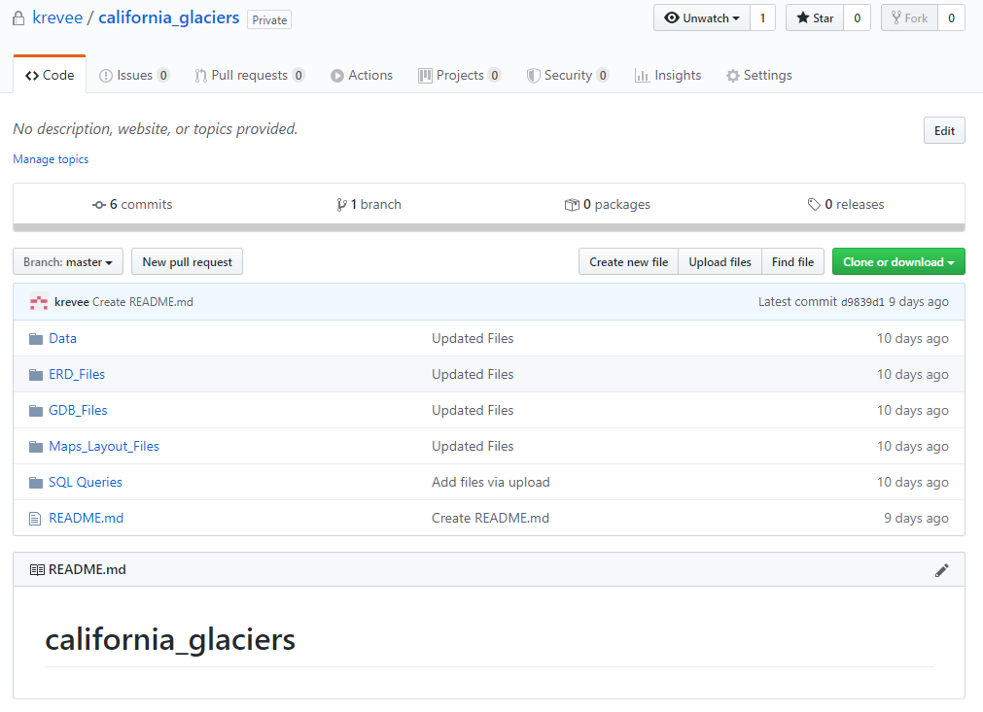
GitHub Demo
SSCI 594 | 24

Slide 25
Questions?
SSCI 594 | 18

